Slide 1
Diet Analyzer with Recommendation Engine
Mark Endicott
MTH 314
Michigan State University

Slide 2
Background & Introduction
My niche is proactive health with data science.
Therefore, I decided to do an independent project!
In short, I built code that analyzed user dietary information (using matrices) and produced recommendations - 3 big parts.
Part 1:
Extract user information
(e.g - weight, ideal weight, and desired weight loss)
Part 2:
Process information
(e.g - calculate calories, daily deficit, macro percentage, etc.)
Part 3:
Make Recommendations
(e.g - “Eat 8% more protein, 12% less carbs, 5% more fat”)

Slide 3
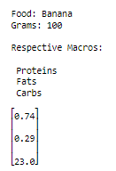
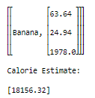
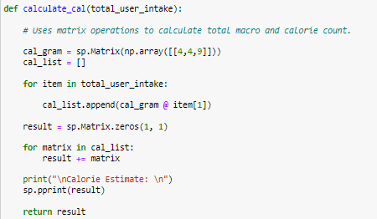
Math & Programming
+86 Bananas
Outside of display and arithmetic operations, the most crucial code:
Scaled the user’s food data matrices.
Using matrix multiplication to find a new calorie estimate.
Displaying arrays and matrices in a visually appealing way.
Obviously using the numpy and sympy libraries throughout my code in jupyter notebooks.

Slide 4
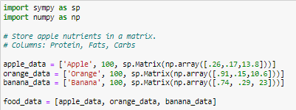
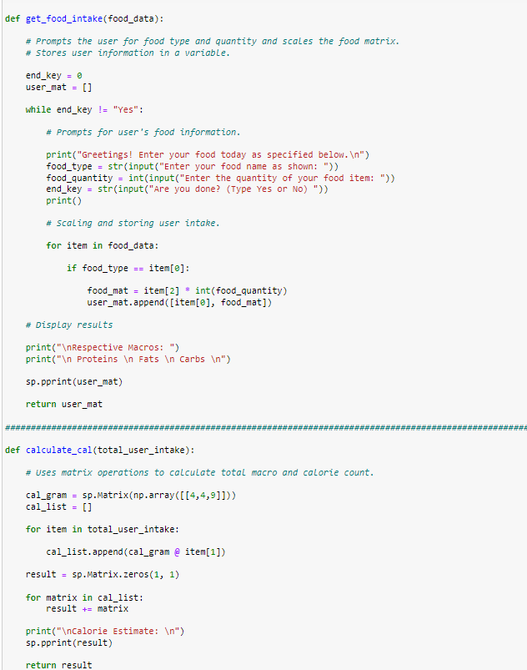
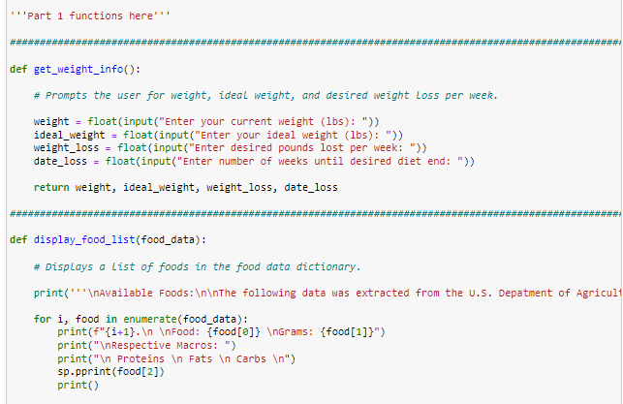
There’s quite a bit more!

Slide 5
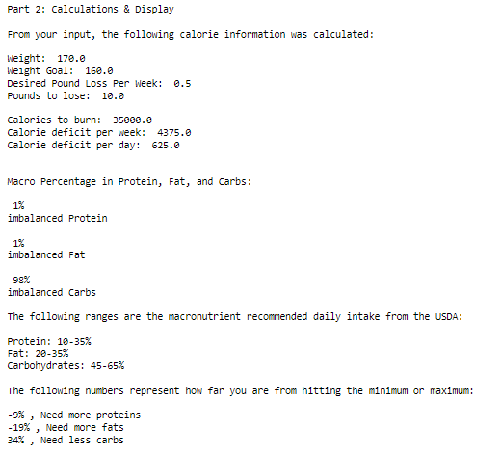
Results
After user entered their information:
Produces daily/weekly calorie deficit within timeline.
Percentage of macros in calorie amount.
Recommendations on which macro to eat more/less of.

Slide 6
Applications & Future Directions
Explore the uses of an inverse in finding missing nutritional values.
Find big CSV files from USDA and get a MUCH bigger food database.
Explore how nutritional components can be visualized using vectors.
Store larger and more specific user intakes, using specific amounts in grams instead of premade amounts.

